Slide 1
Java Writer class
Writer class is an abstract class for writing to character streams.
A Writer is like an OutputStream except that it is character based rather than byte based. In other words, a Writer is intended for writing text, whereas an OutputStream is intended for writing raw bytes.
Writer
BufferedWriter
CharArrayWriter
FilterWriter
OutputStreamWriter
PipedWriter
PrintWriter
StringWriter

Slide 2
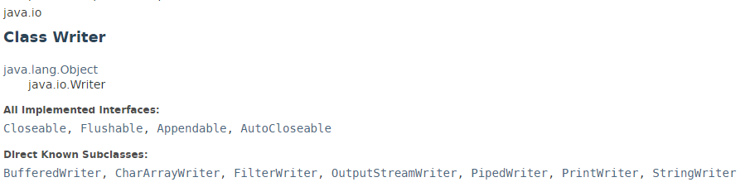
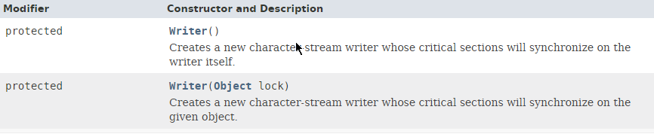
Java Writer class

Slide 3
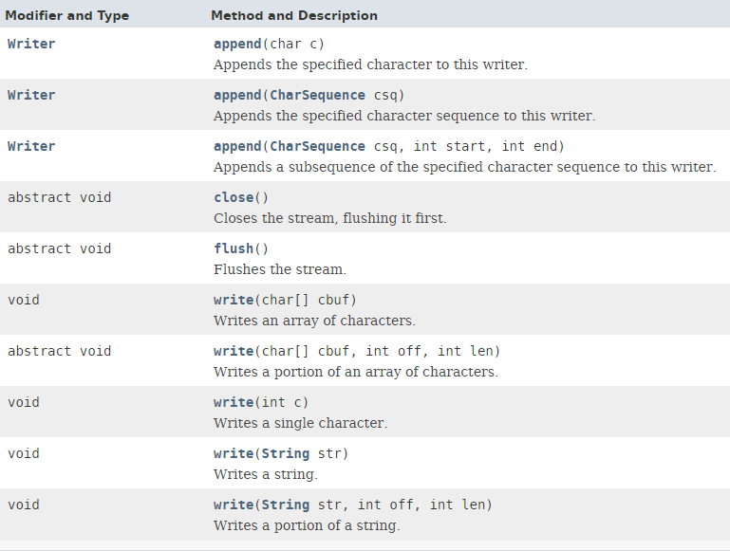
Java Writer class

Slide 4
Java Writer class
https://docs.oracle.com/javase/8/docs/api/index.html?java/io/Writer.html

